Slide 1

VLSI SYSTEM DESIGN EC432
N.KARTHIKEYAN CB107EC038
N.S.V KRISHNA CHAITANYA CB107EC039
G.RAKESH REDDY CB107EC048
SRIKAR GUTTA CB107EC060

Slide 2
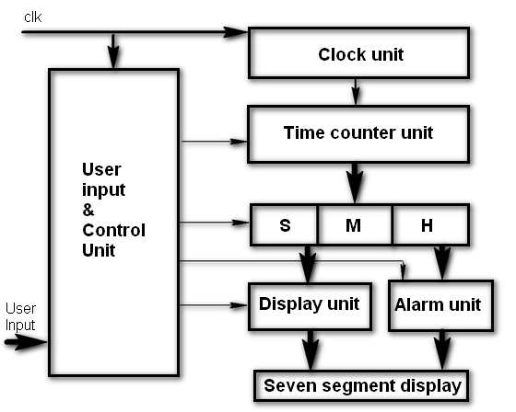
DIGITAL ALARM CLOCK WITH USER-DEFINED INPUT

Slide 3
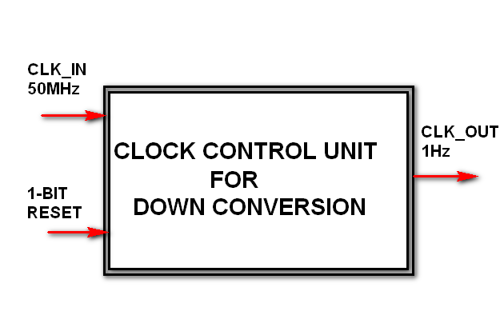
CLOCK UNIT

Slide 4
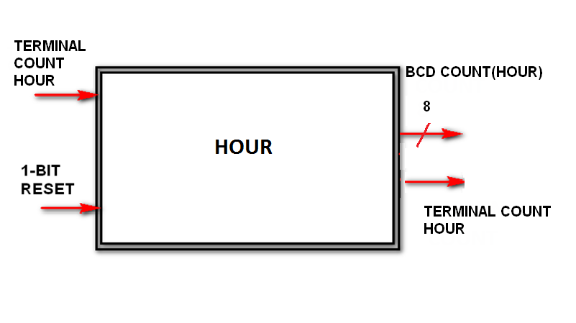
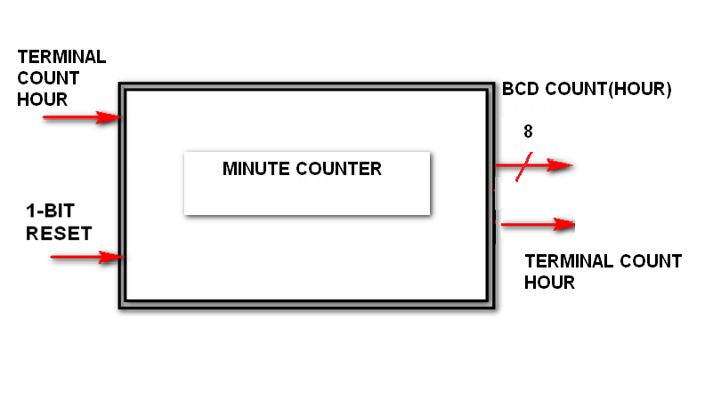
TIME COUNTER

Slide 5
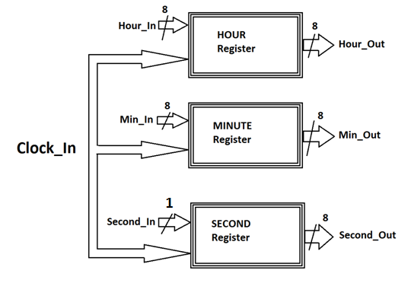
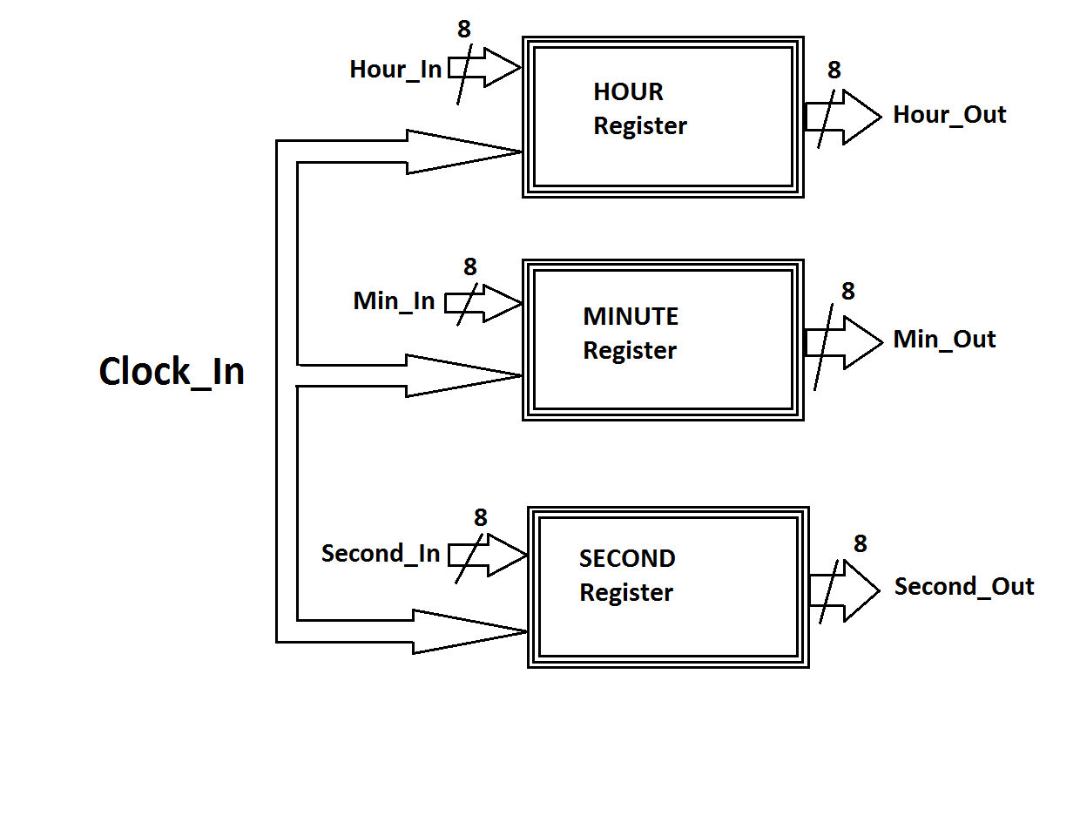
UNIT TIME BLOCKS
Synchronous Time Registers

Slide 6
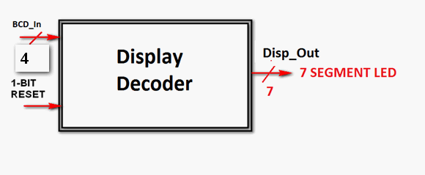
DISPLAY CONTROL UNIT

Slide 7
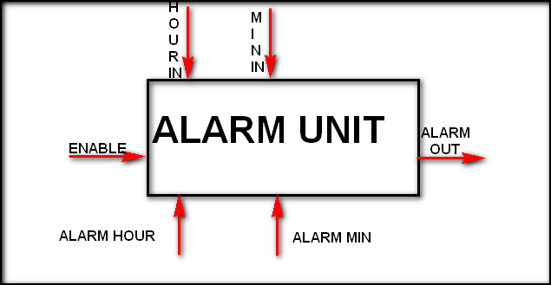
ALARM UNIT

Slide 8
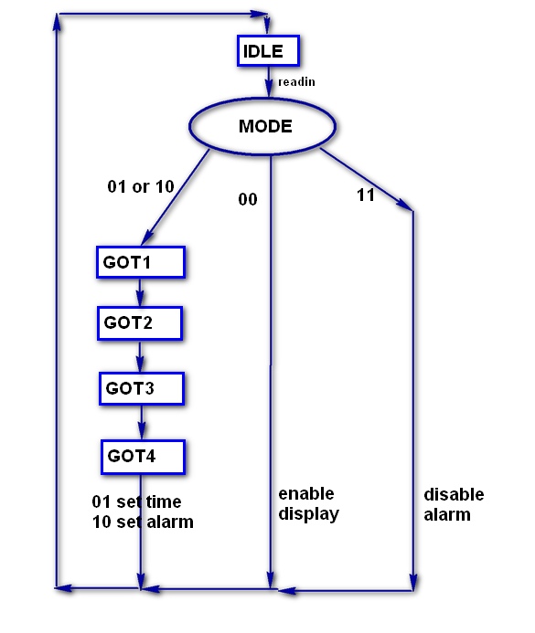
ASM CHART

Slide 9
Future Scope
Instead of having buzzer for alarm, we can generate audible frequency that can be directly given to speaker.
Implementation of customised alarm for any given days in the week.
StopWatch and Date function implementation

